Slide 1
Persistent Environments with
Run:ai
(using conda/mamba & Jupyter)

Slide 2
Background

Slide 3
A (specific) frequently asked question

Slide 4
A (specific) frequently asked question
Client
Ok so I think I get Docker and how it works with Run:ai… but… does this mean I have to make a Docker image for EVERY single one of my conda environments??

Slide 5
A (specific) frequently asked question
Client
Ok so I think I get Docker and how it works with Run:ai… but… does this mean I have to make a Docker image for EVERY single one of my conda environments??
Run:ai
Well, that would be the preferred way to do things.

Slide 6
A (specific) frequently asked question
Client
Ok so I think I get Docker and how it works with Run:ai… but… does this mean I have to make a Docker image for EVERY single one of my conda environments??
Run:ai
Well, that would be the preferred way to do things.
Client
Is there a way I can create and save environments on-the-fly, like I do in my normal workflow?

Slide 7
A (specific) frequently asked question
Client
Ok so I think I get Docker and how it works with Run:ai… but… does this mean I have to make a Docker image for EVERY single one of my conda environments??
Answer: Yes!
Run:ai
Well, that would be the preferred way to do things.
Client
Is there a way I can create and save environments on-the-fly, like I do in my normal workflow?

Slide 8
Solution

Slide 9
How do we do this?

Slide 10
How do we do this?
Conda background

Slide 11
How do we do this?
(Image)
Conda background
When conda is installed, it creates a directory to keep its files.
conda

Slide 12
How do we do this?
(Image)
Conda background
When conda is installed, it creates a directory to keep its files.
Whenever a conda environment is created, it is saved inside a directory called “envs,” within the conda directory.
conda
envs

Slide 13
How do we do this?
(Image)
Conda background
When conda is installed, it creates a directory to keep its files.
Whenever a conda environment is created, it is saved inside a directory called “envs,” within the conda directory.
conda
envs
The idea

Slide 14
How do we do this?
(Image)
Conda background
When conda is installed, it creates a directory to keep its files.
Whenever a conda environment is created, it is saved inside a directory called “envs,” within the conda directory.
conda
envs
The idea
Create a folder called “envs” in your NFS
(your NFS)
envs

Slide 15
How do we do this?
(Image)
Conda background
When conda is installed, it creates a directory to keep its files.
Whenever a conda environment is created, it is saved inside a directory called “envs,” within the conda directory.
conda
envs
The idea
Create a folder called “envs” in your NFS
Mount the NFS “envs” folder, to the location of the conda environments folder in your image.
(Image)
(your NFS)
conda
envs
envs

Slide 16
A note on Jupyter

Slide 17
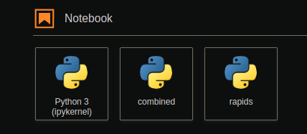
A note on Jupyter
Many users like to have ‘tiles’ for their environment on Jupyter

Slide 18
A note on Jupyter
Many users like to have ‘tiles’ for their environment on Jupyter
(Image)
These setting are saved in a folder called ‘kernels’
kernels

Slide 19
A note on Jupyter
Many users like to have ‘tiles’ for their environment on Jupyter
(Image)
These setting are saved in a folder called ‘kernels’
kernels
We can persist these ‘tiles’ by:

Slide 20
A note on Jupyter
Many users like to have ‘tiles’ for their environment on Jupyter
(Image)
These setting are saved in a folder called ‘kernels’
kernels
We can persist these ‘tiles’ by:
Creating a folder called “kernels” in your NFS
(your NFS)
kernels

Slide 21
A note on Jupyter
Many users like to have ‘tiles’ for their environment on Jupyter
(Image)
These setting are saved in a folder called ‘kernels’
kernels
We can persist these ‘tiles’ by:
Creating a folder called “kernels” in your NFS
Mounting the NFS “kernels” folder, to the location of the kernels folder in your image.
(your NFS)
(Image)
kernels
kernels

Slide 22
A note on Jupyter
Many users like to have ‘tiles’ for their environment on Jupyter
(Image)
These setting are saved in a folder called ‘kernels’
kernels
Adding a tile is done with the following sequence of commands, then refreshing the web browser
We can persist these ‘tiles’ by:
Creating a folder called “kernels” in your NFS
Mounting the NFS “kernels” folder, to the location of the kernels folder in your image.
mamba create -n {your-env-name} ipykernel {your-env-libs}
conda activate {your-env-name}
python -m ipykernel install --user --name={your-env-name}
(your NFS)
(Image)
(If you want to remove the ‘tile’, this command is used)
kernels
kernels
jupyter kernelspec uninstall {your-env-name}

Slide 23
Docker image

Slide 24
Docker image
The docker image that we will be using throughout this notebook is:
jonathancosme/base-notebook-root*

Slide 25
Docker image
The docker image that we will be using throughout this notebook is:
jonathancosme/base-notebook-root*
It is a slightly modified version of the jupyter/base-notebook
image

Slide 26
Docker image
The docker image that we will be using throughout this notebook is:
jonathancosme/base-notebook-root*
It is a slightly modified version of the jupyter/base-notebook
image
You can find more information about jonathancosme/base-notebook-root here:
https://github.com/jonathancosme/jupyter-base-notebook-root

Slide 27
Docker image
The docker image that we will be using throughout this notebook is:
jonathancosme/base-notebook-root*
It is a slightly modified version of the jupyter/base-notebook
image
You can find more information about jonathancosme/base-notebook-root here:
https://github.com/jonathancosme/jupyter-base-notebook-root
*Please note that all our Jupyter images are based off the official Jupyter Docker images. The official images do not have root privileges by default. In order to successfully mount to the ‘kernels’ and ‘envs’ folders in the Jupyter Lab, root privileges are required. We created a custom image that runs root by default. You can see how our image differs from the official image on the github.

Slide 28
Steps

Slide 29
Steps

Slide 30
Steps
Create ‘envs’ and ‘kernels’ folder in our NFS

Slide 31
Steps
Create ‘envs’ and ‘kernels’ folder in our NFS
Mount NFS ‘envs’ and ‘kernels’ folders on an interactive Jupyter lab job

Slide 32
Steps
Create ‘envs’ and ‘kernels’ folder in our NFS
Mount NFS ‘envs’ and ‘kernels’ folders on an interactive Jupyter lab job
Create your environment

Slide 33
Steps
Create ‘envs’ and ‘kernels’ folder in our NFS
Mount NFS ‘envs’ and ‘kernels’ folders on an interactive Jupyter lab job
Create your environment
Test the environment

Slide 34
Step 1
Create ‘envs’ and ‘kernels’ folder in our NFS

Slide 35
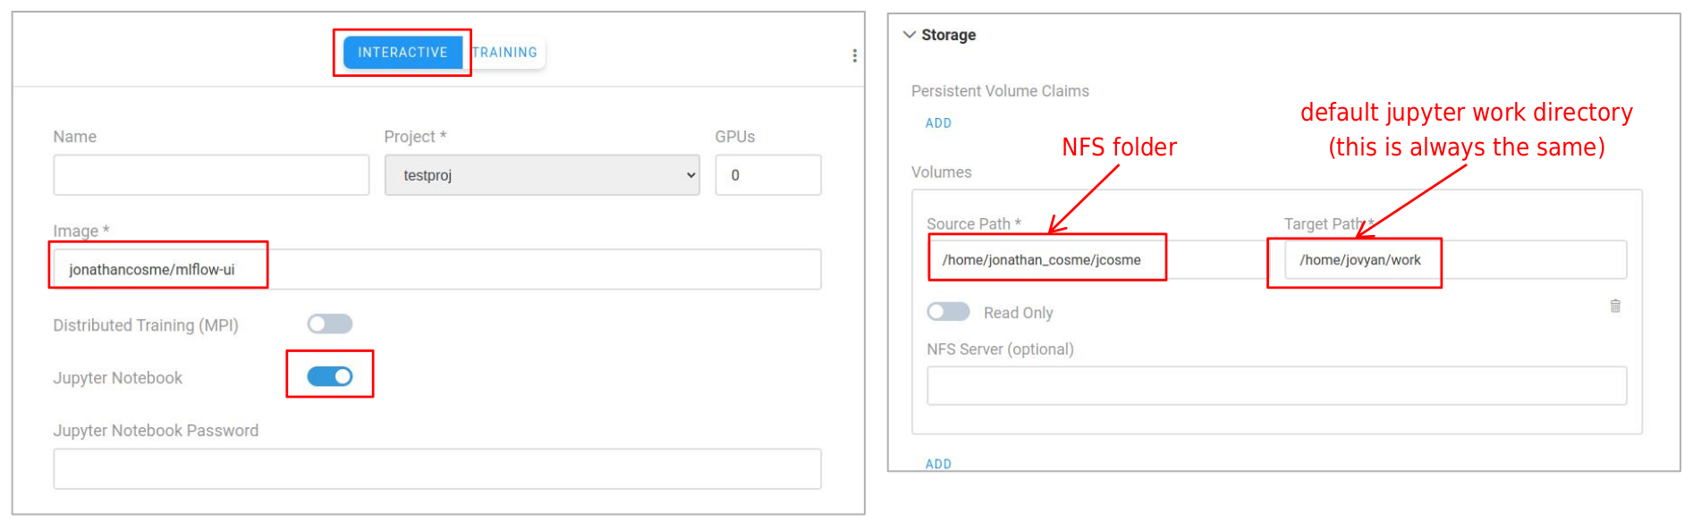
Step 1
Create ‘envs’ and ‘kernels’ folder in our NFS
1.1 Start a Jupyter Lab interactive session, mounting your NFS folder to /home/jovyan/work
jupyter/base-notebook
/home/jonathan_cosme/jcosme
/home/jovyan/work

Slide 36
Step 1
Create ‘envs’ and ‘kernels’ folder in our NFS

Slide 37
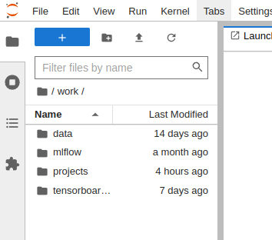
Step 1
Create ‘envs’ and ‘kernels’ folder in our NFS
1.2 Navigate to the ‘work’ directory. You should see your files/folders inside.

Slide 38
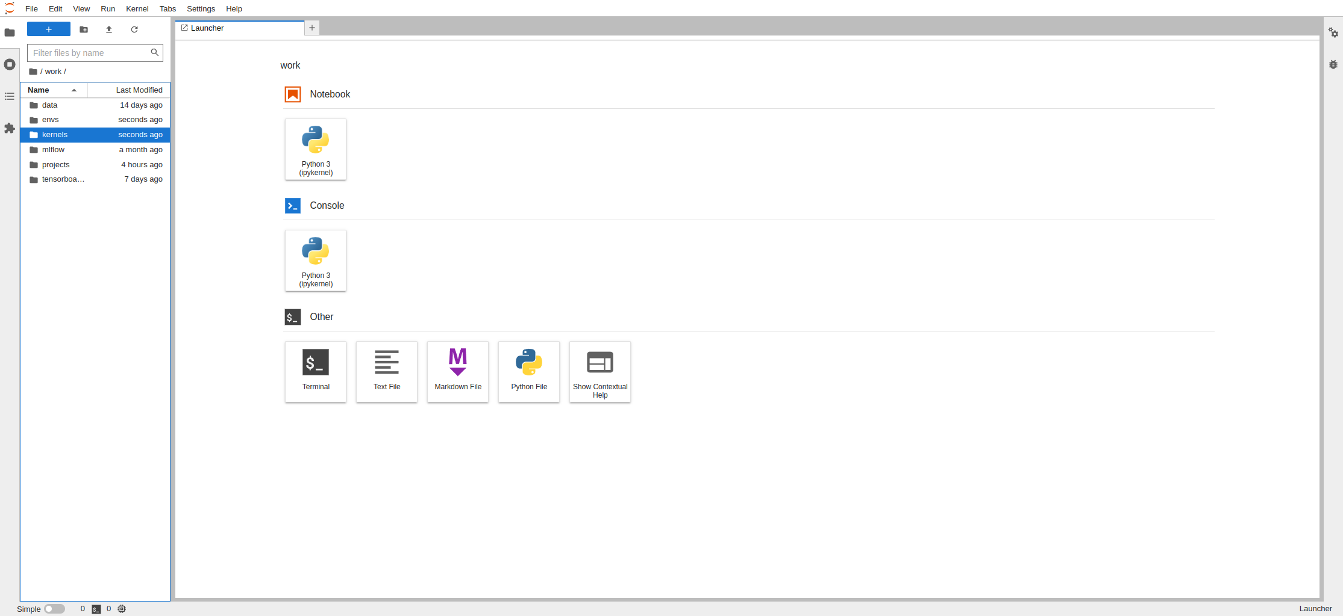
Step 1
Create ‘envs’ and ‘kernels’ folder in our NFS
1.2 Navigate to the ‘work’ directory. You should see your files/folders inside.
1.3 Select the new folder icon, twice (to create two new folders)

Slide 39
Step 1
Create ‘envs’ and ‘kernels’ folder in our NFS
1.2 Navigate to the ‘work’ directory. You should see your files/folders inside.
1.3 Select the new folder icon, twice (to create two new folders)
1.4 Rename the folders ‘envs’ and ‘kernels’

Slide 40
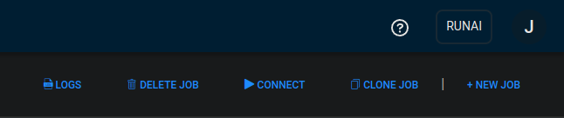
Step 1
Create ‘envs’ and ‘kernels’ folder in our NFS
1.2 Navigate to the ‘work’ directory. You should see your files/folders inside.
1.3 Select the new folder icon, twice (to create two new folders)
1.4 Rename the folders ‘envs’ and ‘kernels’
1.5 Delete the job

Slide 41
Step 2
Mount NFS ‘envs’ and ‘kernels’ folders on an interactive Jupyter lab job

Slide 42
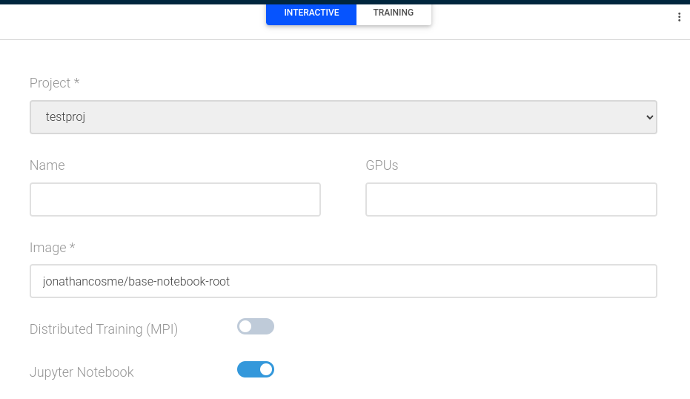
Step 2
Mount NFS ‘envs’ and ‘kernels’ folders on an interactive Jupyter lab job
2.1 Start a Jupyter Lab interactive session using the image jonathancosme/base-notebook-root (do NOT submit job yet)
jonathancosme/base-notebook-root

Slide 43
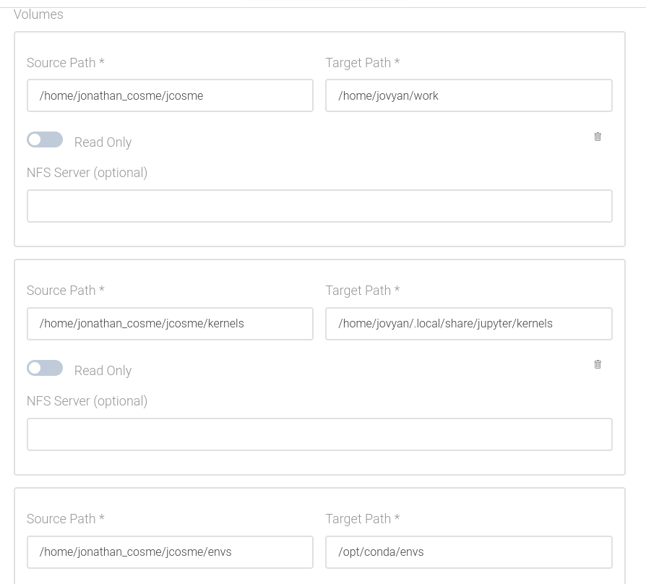
Step 2
Mount NFS ‘envs’ and ‘kernels’ folders on an interactive Jupyter lab job
/home/jonathan_cosme/jcosme
/home/jovyan/work
/home/jonathan_cosme/jcosme/kernels
/home/jovyan/.local/share/jupyter/kernels
/home/jonathan_cosme/jcosme/envs
/opt/conda/envs

Slide 44
Step 2
Mount NFS ‘envs’ and ‘kernels’ folders on an interactive Jupyter lab job
2.2 mounts NFS to /home/jovyan/work
/home/jonathan_cosme/jcosme
/home/jovyan/work
/home/jonathan_cosme/jcosme/kernels
/home/jovyan/.local/share/jupyter/kernels
/home/jonathan_cosme/jcosme/envs
/opt/conda/envs

Slide 45
Step 2
Mount NFS ‘envs’ and ‘kernels’ folders on an interactive Jupyter lab job
2.2 mounts NFS to /home/jovyan/work
/home/jonathan_cosme/jcosme
/home/jovyan/work
2.3 mounts NFS ‘kernels’ folder to /home/jovyan/.local/share/jupyter/kernels
/home/jonathan_cosme/jcosme/kernels
/home/jovyan/.local/share/jupyter/kernels
/home/jonathan_cosme/jcosme/envs
/opt/conda/envs

Slide 46
Step 2
Mount NFS ‘envs’ and ‘kernels’ folders on an interactive Jupyter lab job
2.2 mounts NFS to /home/jovyan/work
/home/jonathan_cosme/jcosme
/home/jovyan/work
2.3 mounts NFS ‘kernels’ folder to /home/jovyan/.local/share/jupyter/kernels
2.4 mounts NFS ‘envs’ folder to /opt/conda/envs
/home/jonathan_cosme/jcosme/kernels
/home/jovyan/.local/share/jupyter/kernels
/home/jonathan_cosme/jcosme/envs
/opt/conda/envs

Slide 47
Step 2
Mount NFS ‘envs’ and ‘kernels’ folders on an interactive Jupyter lab job
2.2 mounts NFS to /home/jovyan/work
/home/jonathan_cosme/jcosme
/home/jovyan/work
2.3 mounts NFS ‘kernels’ folder to /home/jovyan/.local/share/jupyter/kernels
2.4 mounts NFS ‘envs’ folder to /opt/conda/envs
/home/jonathan_cosme/jcosme/kernels
/home/jovyan/.local/share/jupyter/kernels
2.5 Submit job
/home/jonathan_cosme/jcosme/envs
/opt/conda/envs

Slide 48
Step 3
Create your environment

Slide 49
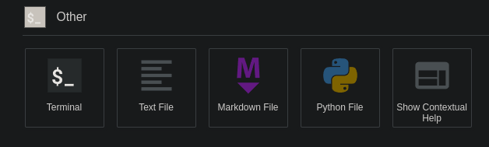
Step 3
Create your environment
3.1 start a terminal, after connecting to the Jupyter lab interactive job

Slide 50
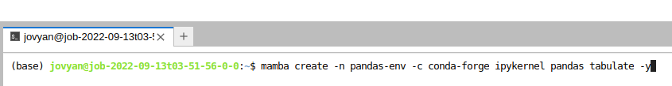
Step 3
Create your environment
3.1 start a terminal, after connecting to the Jupyter lab interactive job
3.2 create an environment using the following format (ipykernel must always be installed in an environment to create a tile)
mamba create -n {your-env-name} -c conda-forge ipykernel {your-env-libraries} -y

Slide 51
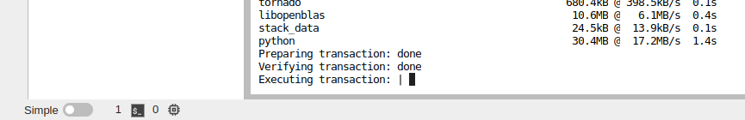
Step 3
Create your environment
3.1 start a terminal, after connecting to the Jupyter lab interactive job
3.2 create an environment using the following format (ipykernel must always be installed in an environment to create a tile)
mamba create -n {your-env-name} -c conda-forge ipykernel {your-env-libraries} -y
3.3 wait for environment to finish creating.
Warning: depending on your NFS speed, the ‘Executing transaction’ step can take a long time (~3 minutes for me)

Slide 52
Step 3
Create your environment

Slide 53
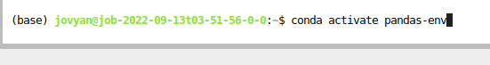
Step 3
Create your environment
3.4 activate the newly created environment using the following format
conda activate {your-env-name}

Slide 54
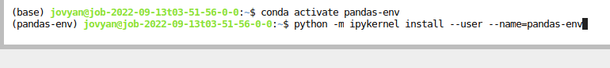
Step 3
Create your environment
3.4 activate the newly created environment using the following format
conda activate {your-env-name}
3.5 Create the tile by using the following format
Python -m ipykernel install --user --name={your-env-name}

Slide 55
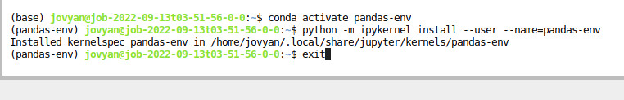
Step 3
Create your environment
3.4 activate the newly created environment using the following format
conda activate {your-env-name}
3.5 Create the tile by using the following format
Python -m ipykernel install --user --name={your-env-name}
3.6 exit the terminal with the following command
exit

Slide 56
Step 3
Create your environment

Slide 57
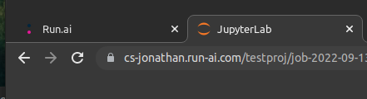
Step 3
Create your environment
3.7 Refresh the Jupyter Lab tab on your browser

Slide 58
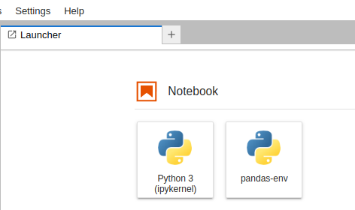
Step 3
Create your environment
3.7 Refresh the Jupyter Lab tab on your browser
3.8 A tile for your new environment should now be visible

Slide 59
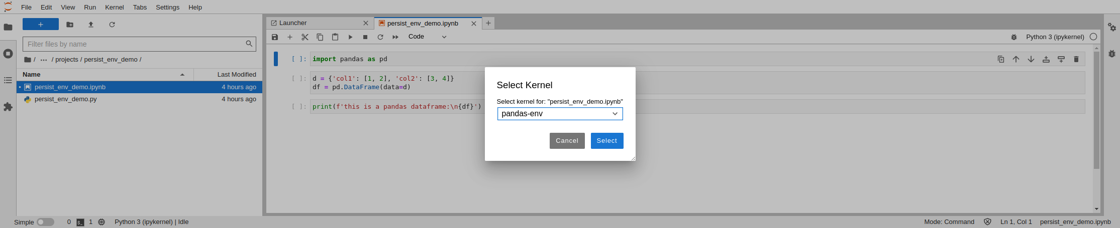
Step 3
Create your environment
3.7 Refresh the Jupyter Lab tab on your browser
3.9 You can also select the new env is notebooks
1
2
3.8 A tile for your new environment should now be visible
3

Slide 60
Step 4
Test the environment

Slide 61
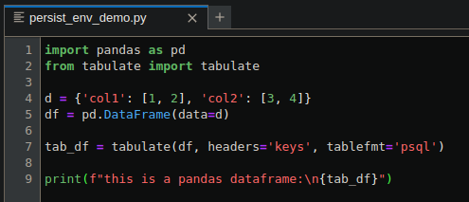
Step 4
Test the environment
Let’s assume I have this python script….

Slide 62
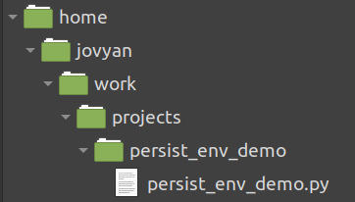
Step 4
Test the environment
Let’s assume I have this python script….
…located here (after mounting my NFS to the Jupyter Lab work directory)

Slide 63
Step 4
Test the environment

Slide 64
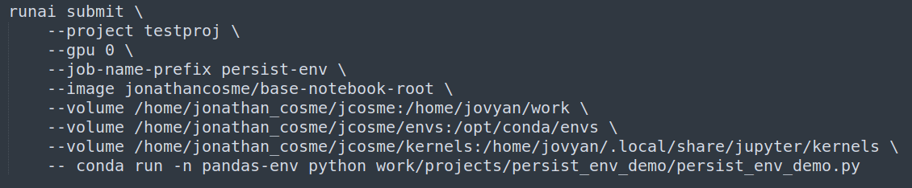
Step 4
Test the environment
This is the runai CLI command I want to run

Slide 65
Step 4
Test the environment
This is the runai CLI command I want to run
1
Use the image jonathancosme/base-notebook-root

Slide 66
Step 4
Test the environment
This is the runai CLI command I want to run
1
2
Use the image jonathancosme/base-notebook-root
Mount NFS to Jupyter work directory

Slide 67
Step 4
Test the environment
This is the runai CLI command I want to run
1
2
3
Use the image jonathancosme/base-notebook-root
Mount NFS to Jupyter work directory
Mount NFS ‘envs’ folder to Jupyter conda envs folder

Slide 68
Step 4
Test the environment
This is the runai CLI command I want to run
1
2
3
4
Use the image jonathancosme/base-notebook-root
Mount NFS to Jupyter work directory
Mount NFS ‘envs’ folder to Jupyter conda envs folder
Mount NFS ‘kernels’ folder to Jupyter kernels folder

Slide 69
Step 4
Test the environment
This is the runai CLI command I want to run
1
2
3
4
5
Use the image jonathancosme/base-notebook-root
Mount NFS to Jupyter work directory
Mount NFS ‘envs’ folder to Jupyter conda envs folder
Mount NFS ‘kernels’ folder to Jupyter kernels folder
Run our command (to follow) in the conda environment named ‘pandas-env’

Slide 70
Step 4
Test the environment
This is the runai CLI command I want to run
1
2
3
4
5
6
Use the image jonathancosme/base-notebook-root
Mount NFS to Jupyter work directory
Mount NFS ‘envs’ folder to Jupyter conda envs folder
Mount NFS ‘kernels’ folder to Jupyter kernels folder
Run our command (to follow) in the conda environment named ‘pandas-env’
Run our python script

Slide 71
Step 4
Test the environment

Slide 72
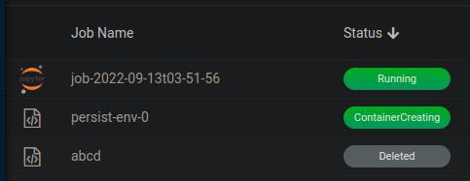
Step 4
Test the environment
4.1 Run the runai CLI command. You should see a new job in the job list

Slide 73
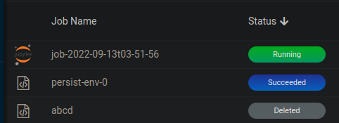
Step 4
Test the environment
4.1 Run the runai CLI command. You should see a new job in the job list
4.2 Wait for the job status to switch to ‘Succeeded’

Slide 74
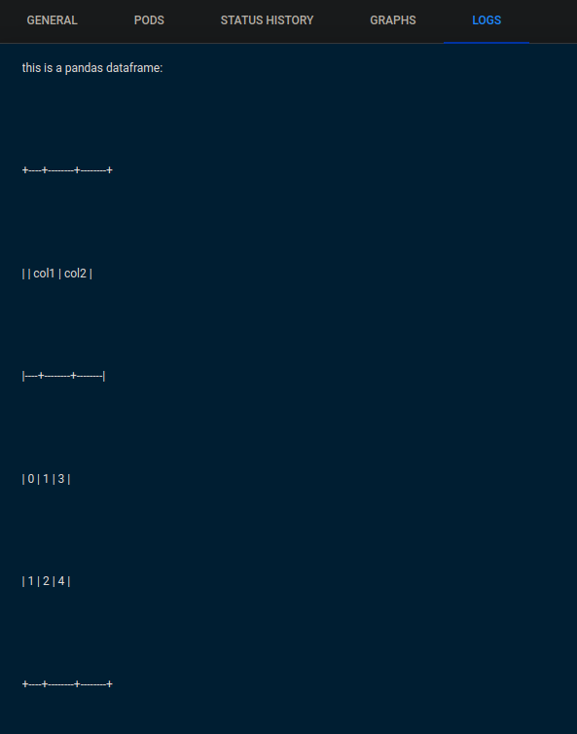
Step 4
Test the environment
4.1 Run the runai CLI command. You should see a new job in the job list
4.3 View the output of the jobs in the Logs tab
4.2 Wait for the job status to switch to ‘Succeeded’

Slide 75
Thank you!

